Slide 1
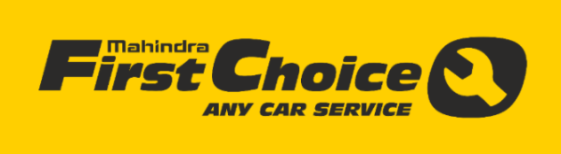
Adil
Rashmi
Kriti
Nilesh

Slide 2
Mahindra First choice
Analysis
01
Mahindra First Choice Services (MFCS) is a company of Mahindra Group and is India’s leading chain of multi-brand car workshops with over 335+ workshops present in 267+ towns & 24 states. The company aims to establish countrywide network of over 400 workshops by March 2018 along with other option to increase revenue
02
Analyze the Current set of data
Identify & Improve
Strengths/Weaknesses
03
Using ML models on current data set for expansion and revenue generation
04
Implement Strategies to Reach those Goals

Slide 3
Data description
Customer data: where the details of the customer like the car owned, state and place of residence, order type, etc are present. Data dimension is of 534000 Customer entries
Invoice data: where information related to customer visits and transactions are recorded, whether a customer as insurance claims, bifurcation of the amount paid, for what type of service did the customer came for, etc…
Material Inventory: where information related to what kind of service did the customer took and what kind of material was used to service, Labour information and the cost for the service, Plant and plant name where the customer took the service.
Plant master – Plant codes , location addresses and few other details related to plants
Products available with Mahindra first choice(MFC)
Service maintenance Package
Car Care
Value pass
Wheel Care
Periodic maintenance service
24/7 roadside assistance
Warranty Beyond Warranty
Accessories

Slide 4
Objectives of Analysis
Expansion
Efficiency increase
Better targeted customers
campaigns
Clustering basis customer behavior

Slide 5
Order & revenue share
Accidental and Mechanical revenue contributes around 86% of the total revenue, more focus should be on to increase other revenue

Slide 6
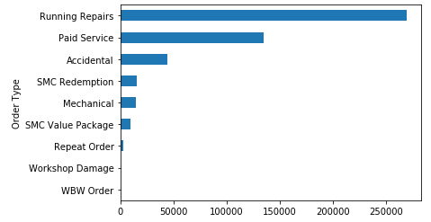
Order and customer type
As we can see that 99% are from retail customers. It is quite clear from above that almost all customers are Retail customers.
We should focus to acquire more of corporate and fleet and insurance customers as MFC will have continuous flow with one time effort
Special drive and campaign to attract corporate and fleet customer
Also if we can get the information on data origin (marketing source) of customers we can focus on target marketing for them and proper distribution of marketing cost for them.

Slide 7
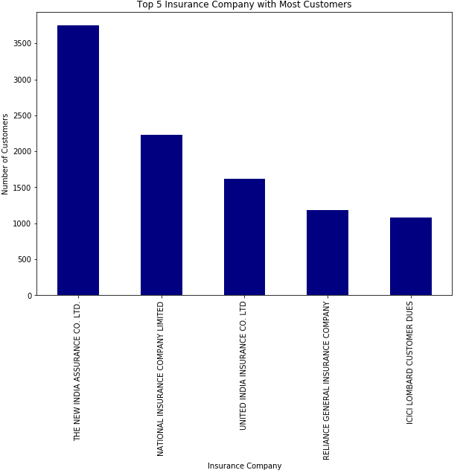
Insurance company
Chart shows the Top 5 insurance companies having the most customers.
However, before it is important to note that the total customer incoming are more than 253K whereas total customer availing insurance is around 15.5K which is about only 6% of the total customer base.
Hence special business actions for these customers may not justify the overall costs.
Business is not as per insurance company proportion, more focus on insurance companies to divert claim vehicles to MFC

Slide 8
Type of work v/s revenue
Accidental
District | Contribution
Tamil Nadu | 21
Maharashtra | 15
Andhra Pradesh | 7
Karnataka | 5
Punjab | 5
Top 5 dis | 53
Total accidental revenue | 76
Top 5 dis share | 70%
share in overall revenue | 24%
Running repair
District | Contribution
Tamil Nadu | 21
Maharashtra | 16
Andhra Pradesh | 7
Karnataka | 6
Gujarat | 4
Top 5 dis | 54
Total revenue from running repair | 68
Top 5 dis share | 80%
share in overall revenue | 25%
Paid service
District | Contribution
Maharashtra | 18
Tamil Nadu | 18
Andhra Pradesh | 5
Karnataka | 5
Uttar Pradesh | 4
Top 5 dis | 50
Total revenue from paid service | 65
Top 5 dis share | 77%
share in overall revenue | 23%
Highest per hour income is from SMC value pack , more focus on acquiring such customer
Second best per hour income is from Accidental works, MFC should get more such customer by focusing on insurance companies

Slide 9
Revenue v/s hour
Type of work | Hours of work(hr) | per hour Income(Rs) | Time spend share | Revenue share
Accidental | 10155823 | 74.39 | 25% | 35%
Mechanical | 1283453 | 36.97 | 3% | 2%
Paid Service | 11369387 | 56.75 | 28% | 30%
Repeat Order | 238821 | 0.02 | 1% | 0%
Running Repairs | 16653580 | 40.76 | 41% | 31%
SMC Redemption | 1015395 | 1.65 | 2% | 0%
SMC Value Package | 102382 | 342.64 | 0% | 2%
WBW Order | 2061 | 63.70 | 0% | 0%
Workshop Damage | 14847 | 0.00 | 0% | 0%
Total | 40835749 | 616.86 | 100% | 100%
Focus on reducing workshop damage cases as it choking bandwidth and workshop space with zero contribution in topline
Running repair is taking most of the bandwidth i.e. taking 41% of total time while contributing to only 31% in revenue

Slide 10
MFC v/s Manufacturer
Manufacturer
MFC
Maruti contributes to 50% of the total Car reg , while MFC has only 30% contribution, more focus on Maruti make vehicle
More focus on vehicles who are exiting from Indian market like GM
More focus on vehicle make like fiat whose network workshop is less
More focus on small segment vehicle as these are the price sensitive customers

Slide 11
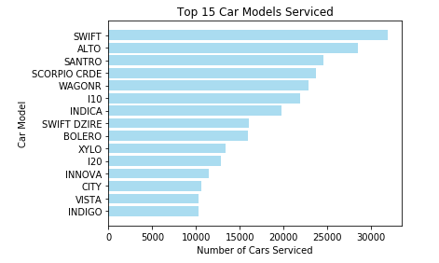
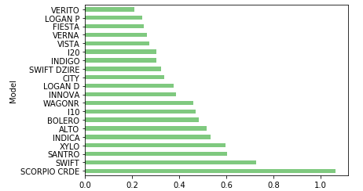
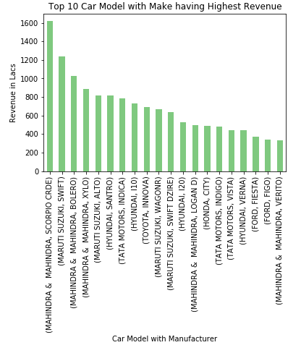
Revenue v/s make & model
Sr no | Make model | Avg revenue
1 | LAND ROVER | 9238
2 | MERCEDES BENZ | 6814
3 | MAHINDRA & MAHINDRA | 6638
4 | BMW | 6608
5 | SKODA | 5813
6 | TOYOTA | 5679
7 | MITSUBISHI MOTORS | 5058
8 | FORCE | 4984
9 | FIAT | 4631
10 | TATA MOTORS | 4554
11 | FORD | 4508
12 | HONDA | 4449
13 | VOLKSWAGEN | 4320
14 | PREMIER AUTOMOBILES | 4287
15 | GENERAL MOTORS | 4213
16 | RENAULT | 3977
17 | AUDI | 3917
18 | PORCHE | 3848
19 | HYUNDAI | 3741
20 | NISSAN | 3695
21 | DAEWOO | 3456
22 | MARUTI SUZUKI | 3278
23 | HINDUSTAN MOTORS | 2979
24 | VOLVO | 2438
25 | SONALIKA | 2055
26 | SAN MOTORS | 450
27 | MORRIS | 353
28 | JEEP | 179
Model wise revenue
Mahindra Scorpio, Maruti Swift, Hyundai Santro, Tata Indica, Mahindra Xylo, Bolero are most serviced cars also generates high revenue. High end cars like Land Rover, Mercedes Benz, BMW, Audi etc. are less in no to be serviced but still average revenue is more than low end cars.
Offers, promotions or programs are needed to attract high end cars more.
This can help to manage inventory in better way.

Slide 12
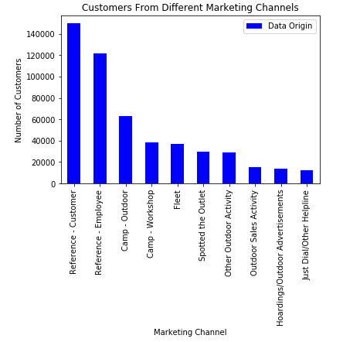
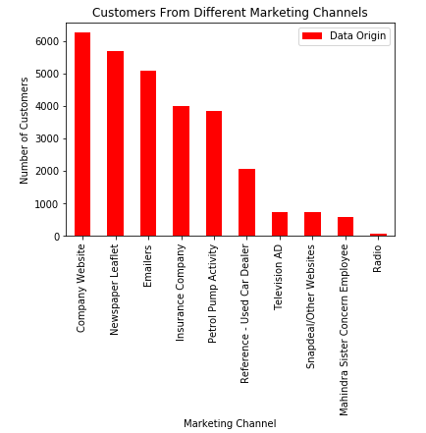
Marketing campaigns
Here we studied the customer data. We have data origin column which tells about how customer came to MFC. Highest no. of customers has visited MFC through existing customer reference and employee reference. It means customer are happy with the services.
Outdoor camps & workshops, fleets also brought significant amount of customers. We can focus more promotional activities on them to increase customers. (Marketing resources)
We can see the lowest contributing sources are radio ad, TV ad, snapdeal & other websites, so the cost can be deducted for promotion on these resources OR better promotional activities with offers can be planned to increase the sales.

Slide 13
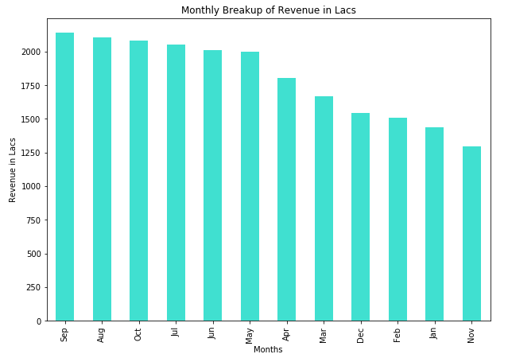
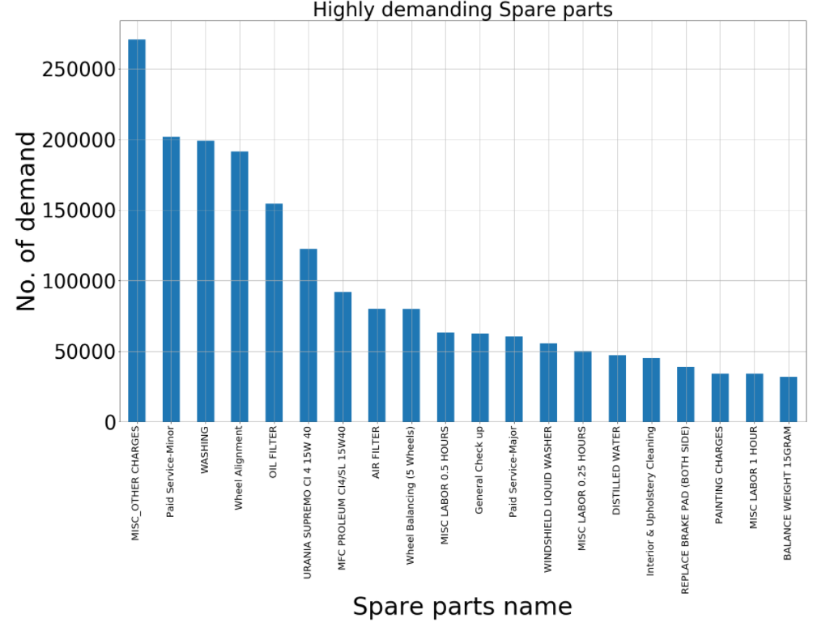
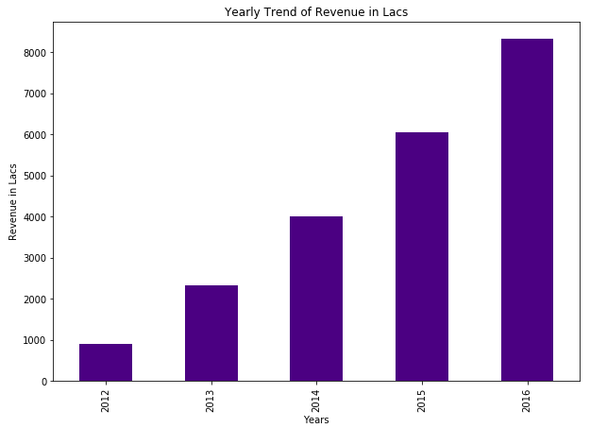
Inventory planning
May to Oct are peak months on terms of revenue generating . It means after the rains people tend to take the services more, so supply chain of the materials and man power management should be planned properly as per the demand in these months.
From November to February the demand of services is significantly less. Some Year-end offers or Seasons’ end sale can be offered to customers to increase the revenue of these months.
For inventory planning business growth, marketing campaign for slack period (low demand period) to be considered.

Slide 14
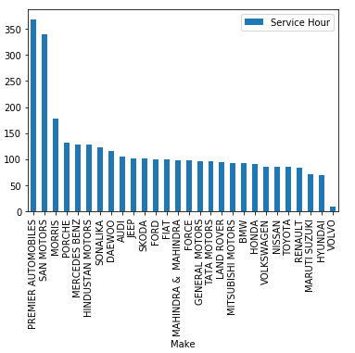
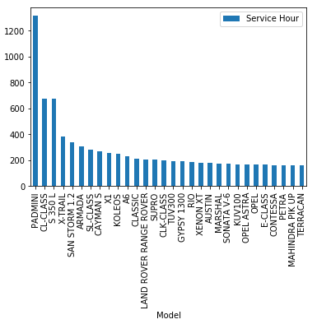
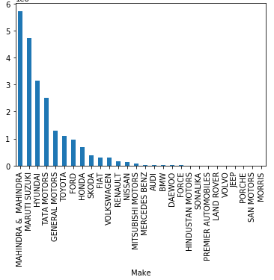
Service time
Absolute model takes service time
Team should be trained to handle these model better to reduce service time.

Slide 15
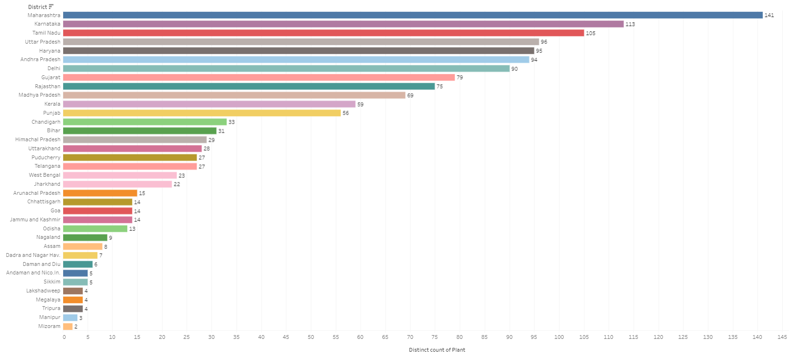
Expansion plan
Presence in Delhi to be increased as it contributes to 9% of total vehicle while MFC is getting only 1%
Gujrat had 9% of total vehicle reg while in MFC it had only 5% share
Kerala has 8% of registered vehicle and in MFC share it contributes only 1%
Not much presence in West Bengal and Jharkhand which together contributes to 6% of total vehicle base

Slide 16
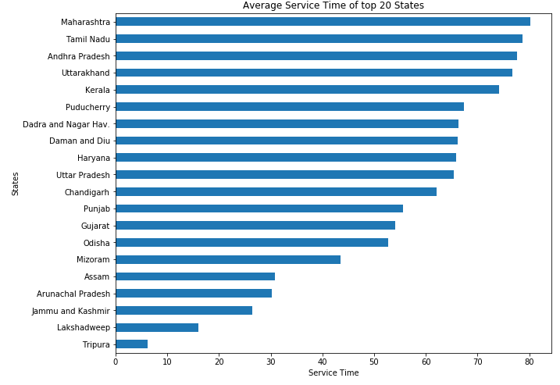
Expansion plan cont…
Maharashtra , TN,AP, Uttarakhand and Kerala are top states with highest average service time and hence more MFC service station can be planned to improve customer experience and attract more customers
These top 5 states have good presence hence can look for 2nd step to have a specialized workshop to cater high end customers

Slide 17
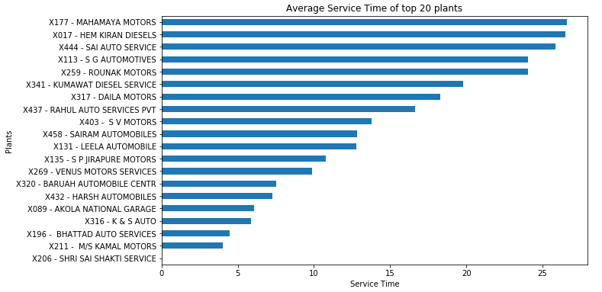
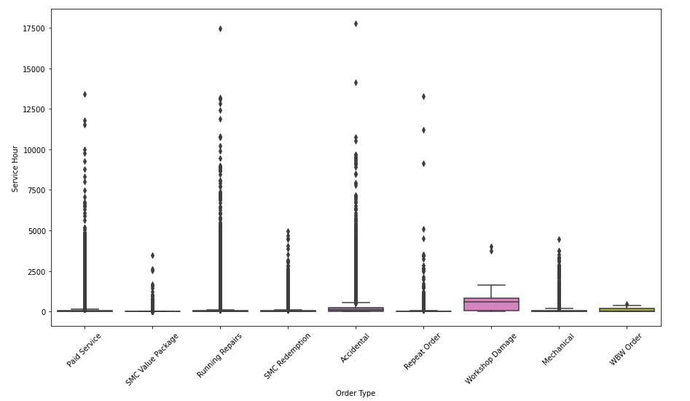
Efficiency
Order type | TAT (Days)
Workshop Damage | NA
Accidental | 9 days
WBW order | 5 days
Mechanical | 3 days
Paid service | 3 days
Repeat order | 3 days
SMC redemption | 2 days
Running repair | 2 days
SMC value package | 10 hours
To increase workshop efficiency and giving the exact vehicle delivery time to customer to collect his car without any reminder, will save time of workshop and of customer and will lead to better customer experience.
By having fix TAT vehicles delivery can be planned more effectively and accurately
Fixed time for each type of service to standardize the customer experience
Effective use of time by knowing targe time to complete the job
Informed customer will be a happy customer as it will improve customer experience

Slide 18
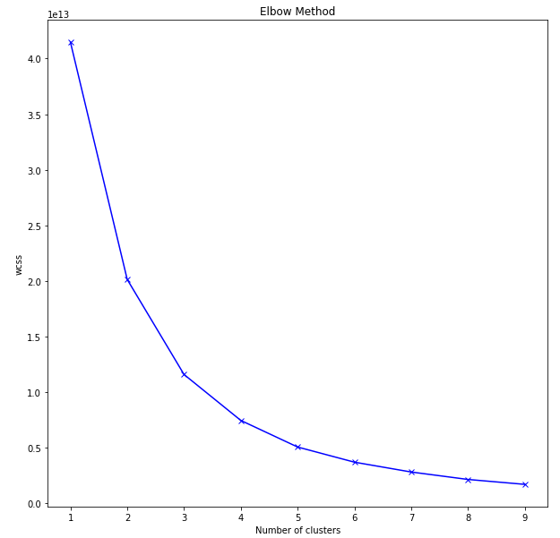
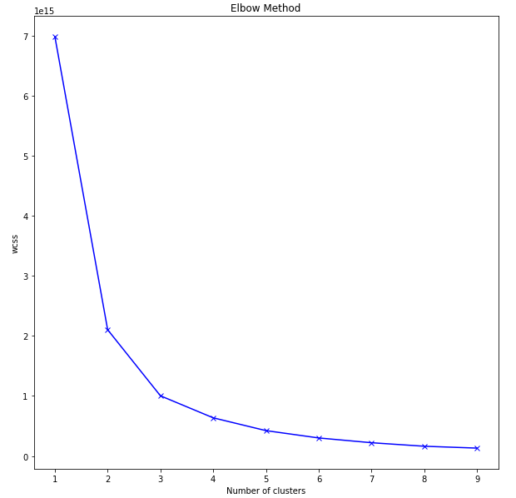
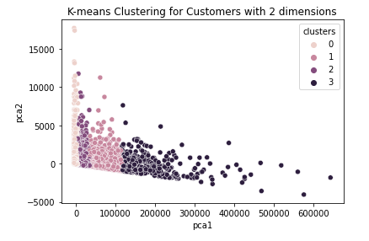
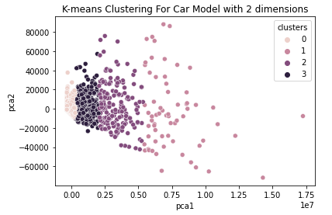
Customer Segregation
Clustering basis customer
Clustering basis make model

Slide 19
Customer Segregation
Low revenue eraning cluster
Customer ID
E1205
MFCWP01
MFM15
E11111
148721
Low revenue eraning cluster car model
Make Model
TATA MOTORS - VISTA
HYUNDAI - VERNA
TATA MOTORS - INDIGO
MAHINDRA & MAHINDRA - BOLERO
HONDA - CITY
Medium revenue eraning cluster
Customer ID
MFCCM14
12466
E1506
MFCC018
17046
Medium revenue eraning cluster car model
Make Model
MARUTI SUZUKI - EECO
TATA MOTORS - SUMO
HYUNDAI - SANTRO
MARUTI SUZUKI - 800
GENERAL MOTORS - TAVERA
These customer will be sold low ticket size product
Experience representative to be deployed to cross sell product to higher segment in the list
These customer will be in our lowest priority
These customer to be pitched with high ticket size product
Best tele caller to be deployed to convince these customers .
High revenue earning cluster
Customer ID
241519
144414
50109
149537
172057
High revenue earning cluster car model
Make Model
MAHINDRA & MAHINDRA - LOGAN D
TOYOTA - INNOVA
MARUTI SUZUKI - RITZ
MAHINDRA & MAHINDRA - BOLERO PIK UP
MAHINDRA & MAHINDRA - BOLERO
Very High revenue earning cluster
Customer ID
MFCCM14
164806
171679
188257
88486
Vey High revenue earning cluster car model
Make Model
MARUTI SUZUKI - SWIFT
MAHINDRA & MAHINDRA - SCORPIO CRDE
MAHINDRA & MAHINDRA - XYLO
HYUNDAI - SANTRO
MARUTI SUZUKI - ALTO
These are the customer with high paying capacity, top products can be sold to these customers
Special offers to retain these type of customers
Special kindly of service to be offered to these kind of customers

Slide 20
Recommendation
MFC should have specialized technician team to handle high end cars
Part availability should be there for high end cars as these parts take 2-3 days time to reach to workshop hence should be planned properly to reduce ideal time when vehicle is lying in workshop
Marketing to be planned to attract high end customers as these are the high-ticket size customers

Slide 21
Thank You

